Slide 1
Drought Risk Analysis for Africa
June 2026

Slide 2
Objective:
“To enable a "Cross-Continental Spread" of risk”
Problem:
A single Drought event can trigger simultaneous payouts across multiple districts.
Solution:
Identifying "Uncorrelated Regions." By insuring districts that do not fail at the same time, the insurance fund maintains financial stability.

Slide 3
Area of Interest
Global Administrative Areas (GADM 4.1) Administrative Level districts.
Global Land Analysis and Discovery (GLAD) - 30m - Landsat time series.
Centroid-based spatial joining ensures we capture the core climatic profile of every district.
The Maize Focus: Utilizing GEOGLAM Maize 1 - 5km calendars to isolate the primary growing season for maximum impact (Group on Earth Observations Global Agricultural Monitoring, 2024).

Slide 4
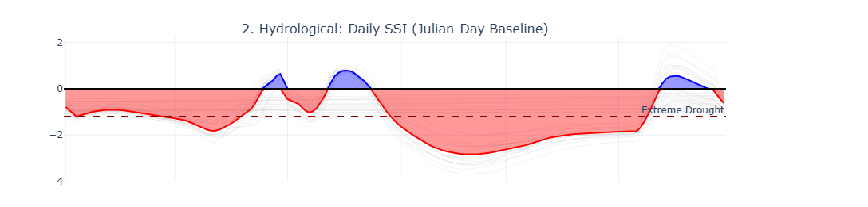
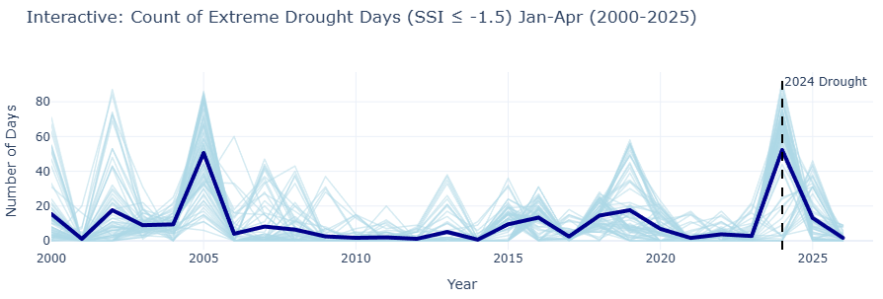
Standardized Soil Moisture Index (SSI)
Z-Score Standardization: Converts raw moisture data into probability-based Z-scores (AghaKouchak, 2014).
Historical Baseline: Establishes a 25-year moisture record for every specific day of the year.
Gamma Fitting: Models data using Gamma curves to handle non-negative, right-skewed distributions.
Normal Mapping: Maps current percentiles to a Standard Normal SSI for universal risk assessment.

Slide 5
25-Year: Historic Stress
Visualizing Two Decades of Drought Evolution.
Cumulative "Drought Days" per season per district.
The Threshold: SSI ≤ -1.0 (WMO, 2012; McKee, Doesken and Kleist, 1993).
Risk Window: Ignores the first 25% of the season. This ensures we only count drought during the critical flowering and grain-fill stages where maize is most vulnerable.

Slide 6
Correlations
Computes a Pearson correlation matrix of annual drought days between all district pairs across Africa.
Reveals how large-scale climate drivers sync. drought risk across distant regions.
Diversification opportunities insuring uncorrelated regions lowers the total capital reserves required by the insurer (Carrão et al., 2016).

Slide 7
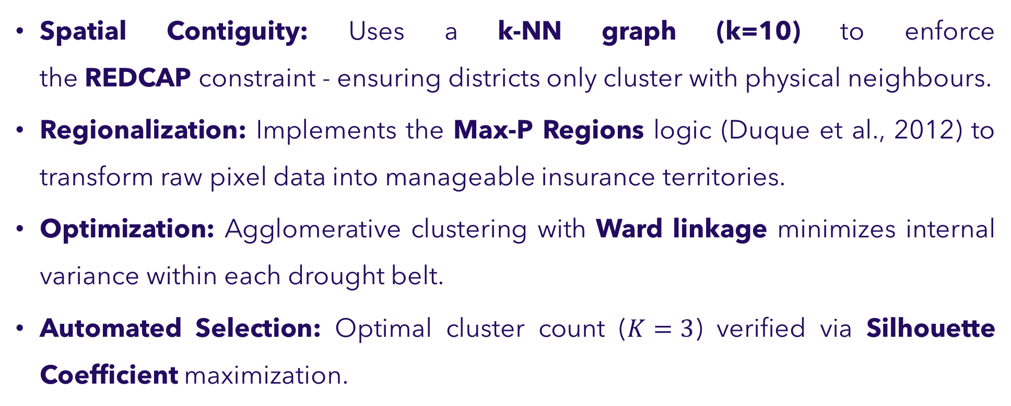
Spatially-Constrained Drought Risk Zones
X_{combined}​=[Weather⋅0.9∥Coordinates⋅0.1]
Spatial Contiguity: Uses a k-NN graph (k=10) to enforce the REDCAP constraint - ensuring districts only cluster with physical neighbours.
Regionalization: Implements the Max-P Regions logic (Duque et al., 2012) to transform raw pixel data into manageable insurance territories.
Optimization: Agglomerative clustering with Ward linkage minimizes internal variance within each drought belt.
Automated Selection: Optimal cluster count ($K=3$) verified via Silhouette Coefficient maximization.

Slide 8
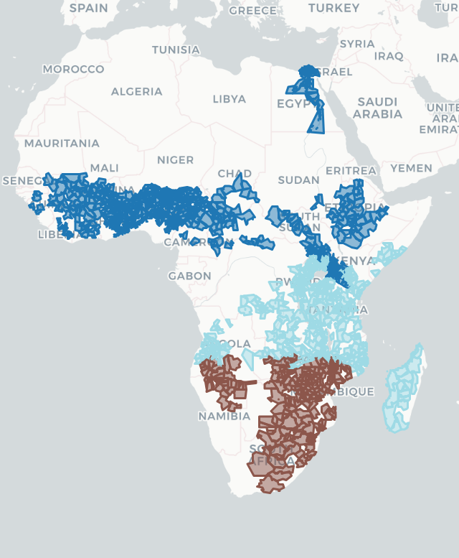

Spatially-Constrained Drought Risk Zones ($λ=0.1,K=3$)
The algorithm naturally identified three distinct geographic zones:
Northern/Sahel Belt (Dark Blue - G1): Shared risk across the northern agricultural chain (Senegal to Ethiopia) (Nicholson, 2013).
Southern Africa (Brown - G2): A distinct climate zone driven primarily by the ENSO (El Niño) signal (Ropelewski & Halpert, 1987).
East Africa & Madagascar (Light Blue - G3): Demonstrates that Madagascar’s climate risk correlates strongly with the East African coast (Marchant et al., 2007).
(Duque et al., 2012; Guo, 2008)

Slide 9
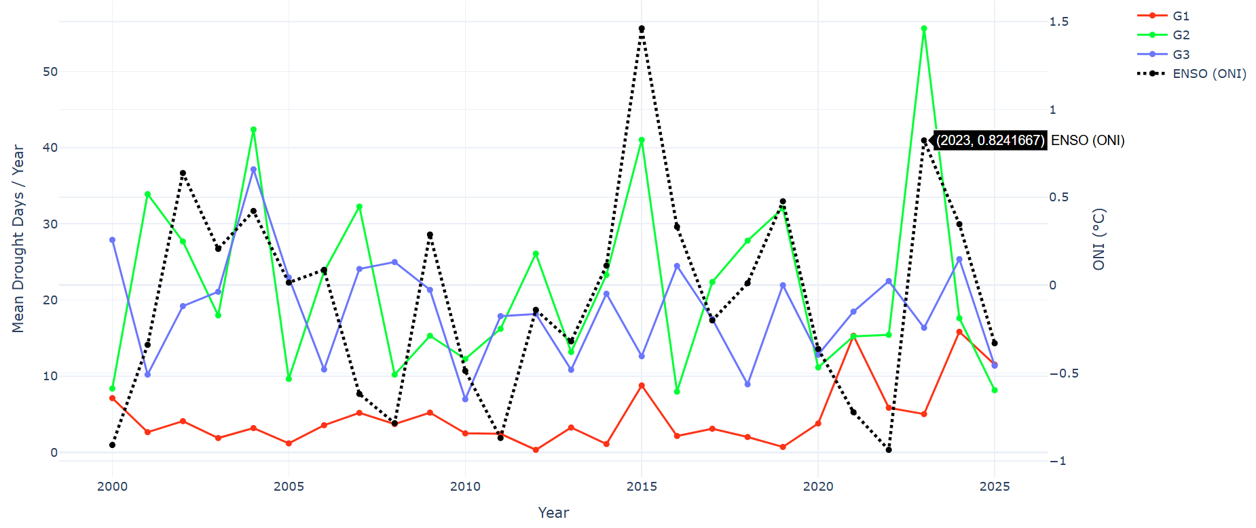
Custer Drought Trajectories vs ENSO ($λ=0.1,K=3$)
G1 (Red) and G3 (Blue) do not follow the black dotted line.
-0.033
+0.595
+0.005
G2 (Southern Africa) follows the ENSO signal, showing strong spikes during 2015 - 2016 and 2023 - 2024.
G1 (Northern/Sahel) remains consistently lower, indicating reduced drought frequency relative to other the clusters.

Slide 10
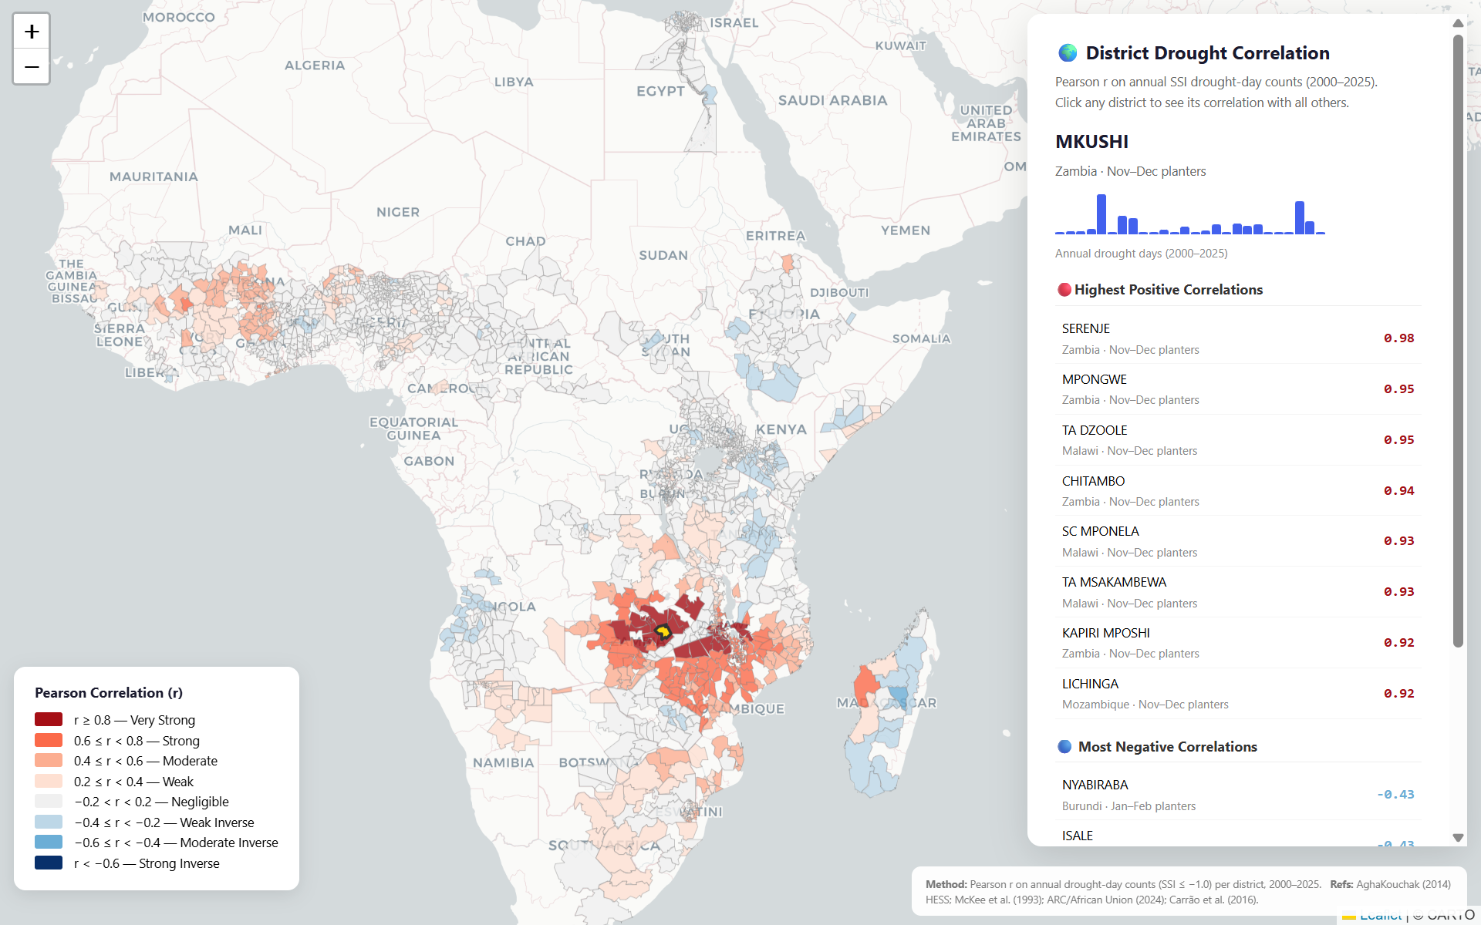
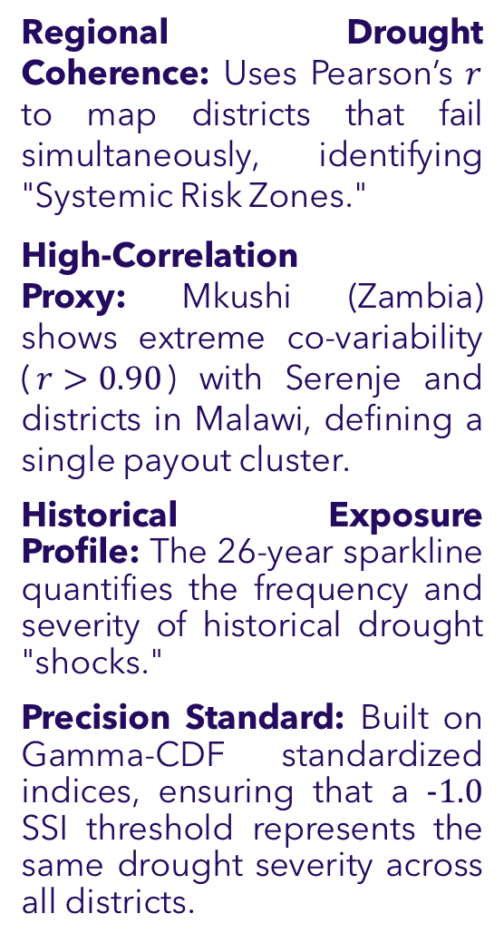
Continental Diversification: Southern Africa
Regional Drought Coherence: Uses Pearson’s $r$ to map districts that fail simultaneously, identifying "Systemic Risk Zones."
High-Correlation Proxy: Mkushi (Zambia) shows extreme co-variability ($r>0.90$) with Serenje and districts in Malawi, defining a single payout cluster.
Historical Exposure Profile: The 26-year sparkline quantifies the frequency and severity of historical drought "shocks."
Precision Standard: Built on Gamma-CDF standardized indices, ensuring that a $−1.0$ SSI threshold represents the same drought severity across all districts.

Slide 11
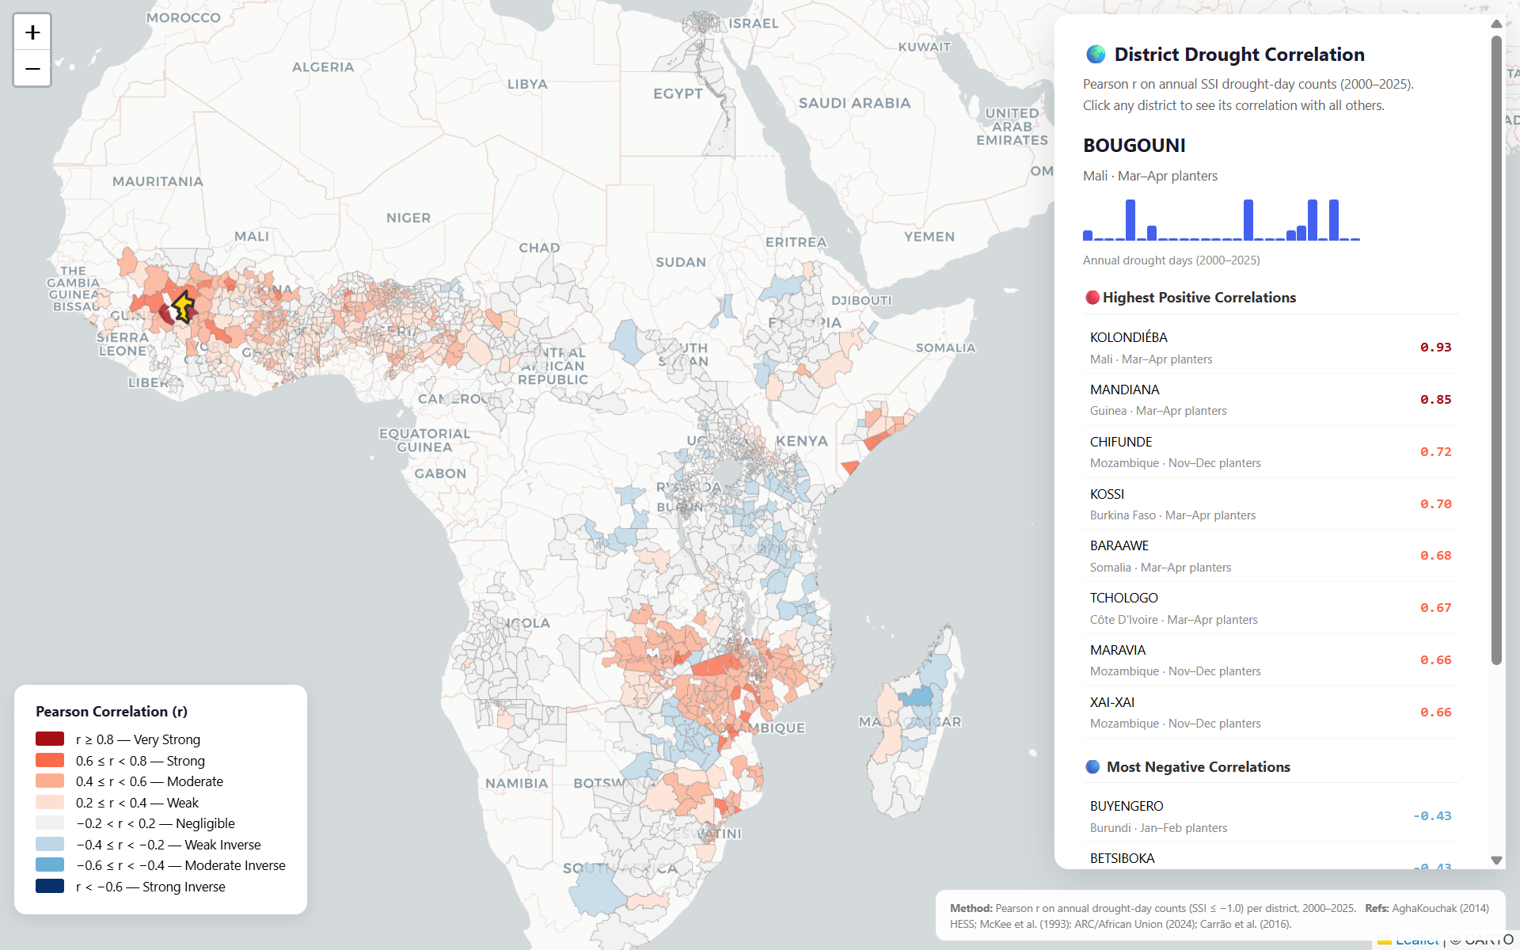
West Africa
Strategic Independence: Demonstrates that West African drought drivers (Sahelian Monsoon) are uncorrelated with Southern African drivers.
Sahelian Risk Cohesion: Bougouni (Mali) shows high correlation with Guinea and Burkina Faso, but zero correlation with the Zambian cluster.
The 'Natural Hedge': Proves that drought in the South does not imply drought in the North, allowing for capital reserve optimization.
Maize-Specific Targeting: Results are filtered through GEOGLAM Maize 1 crop calendars, focusing risk assessment only on the critical 75% of the growing season.

Slide 12
References:
AghaKouchak, A. (2014) ‘A baseline probabilistic drought forecasting framework using standardized soil moisture index’, Hydrology and Earth System Sciences, 18(7), pp. 2515–2526. doi: 10.5194/hess-18-2515-2014.
Carrão, H., Naumann, G. and Barbosa, P. (2016) ‘Mapping global patterns of drought risk: An empirical framework based on sub-national estimates of hazard, exposure and vulnerability’, Global Environmental Change, 39, pp. 108–124. doi: 10.1016/j.gloenvcha.2016.04.012.
Group on Earth Observations Global Agricultural Monitoring (GEOGLAM) (2024) Crop Monitor for Early Warning (CM4EW) Calendars V1.4. Available at: https://cropmonitor.org/ (Accessed: 29 April 2026).
McKee, T. B., Doesken, N. J. and Kleist, J. (1993) ‘The relationship of drought frequency and duration to time scales’, Proceedings of the 8th Conference on Applied Climatology, Anaheim, California, 17–22 January. Boston: American Meteorological Society, pp. 179–184.
World Meteorological Organization (WMO) (2012) Standardized Precipitation Index User Guide. WMO-No. 1090. Geneva: World Meteorological Organization.

